Slide 1
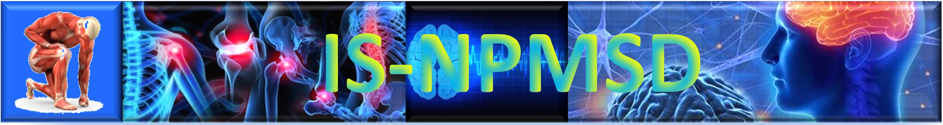
Neuro-Psych-Musculo-Skeletal-Derm
Course Coordinators:
Gloria Klapstein - Principal coordinator, Psychiatry
Jason Massa - Neurology
Bronwyn Sing - MSK med
Laurena Dongmo Fotsing - Dermatology
Schedule an appointment with Dr. Klapstein:
https://calendly.com/gklapstein
Notes:
Welcome back to your second year of Medicine. I’m Dr. Klapstein, and I am your Course coordinator for ISMSN. All of your course coordinators this term have worked together to plan an interesting, integrated, and challenging fall schedule. As your largest course this fall, ISMSN will offer a variety of learning events, including lectures, labs, assignments and group work.
Almost all of these events will be conducted as hybrid, with live lecture in LHB and synchronous Zoom. Certain events will be conducted only on campus, and some will be only on Zoom. Check the weekly schedule pages to see where and how each event will be presented. The fall schedule was carefully constructed with priority on the logical progression of curricular material between all courses and with your ability to conveniently access everything you need being top of mind. Considerations were made in scheduling of exams and large assignments to minimize the number of high-stress periods during the term.

Slide 2
To Pass the Course: (passing grade is at least 70.00%)
Students must pass the course by obtaining all of the following:
Passing grade in Module Exam weighted average score
Pass Module exams adding up to at least 70.00% of the total course
Pass Medical Knowledge competency
70.00% of MK questions on Module exams
Pass each MK subject thread
Pass Patient Care competency
70.00% of PC questions on Module exams
Pass Professionalism Competency
2. Students must attend at least 79%, without rounding, of mandatory events

Slide 3
Remediations - All components of course are remediable, except:
No remediations will be offered if you fail parts of the course adding to > 30.00%
any combination of module exams or
any combination of competencies, or
any combination of subject threads
No remediations will be offered if you attend <79% of mandatory events
Overall Course grade is calculated 100% from Examsoft questions
MK and PC Competencies are calculated only from Examsoft questions
Only MK and PC are tracked in Canvas gradebook
MK will certainly be >30% of exam questions, so will not be remediable
PC may be remediable, unless >30% of exam questions
MK subject thread remediability is determined by % of course, not % of MK competency
Professionalism grade is calculated separately (see Professionalism metric table)
is remediable, unless conditions above are met
You must pass all offered remediations to pass the course

Slide 4
Module Exam Metric
 | Course Weight %
Module 1 exam | 12.5
Module 2 exam | 7.8
Module 3 exam | 7.4
Module 4 exam | 10.7
Module 5 exam | 12.0
Module 6 exam | 12.3
Module 7 exam | 11.6
Module 8 exam | 6.3
Module 9 exam | 8.8
Module 10 exam | 10.6
% of the Course | 100.00

Slide 5
MK Subject Thread Metric
 | % of Course
Anatomy | Calculated in Canvas as cumulative running total throughout the course
Biochem/Mol Bio/Genetics/Cell Bio
Histology
Immunology
Microbiology
Pathology
Pharmacology
Physiology
Final Thread grades will not be calculated until the end of the course. A running total of thread grades will be updated after every module exam.

Slide 6
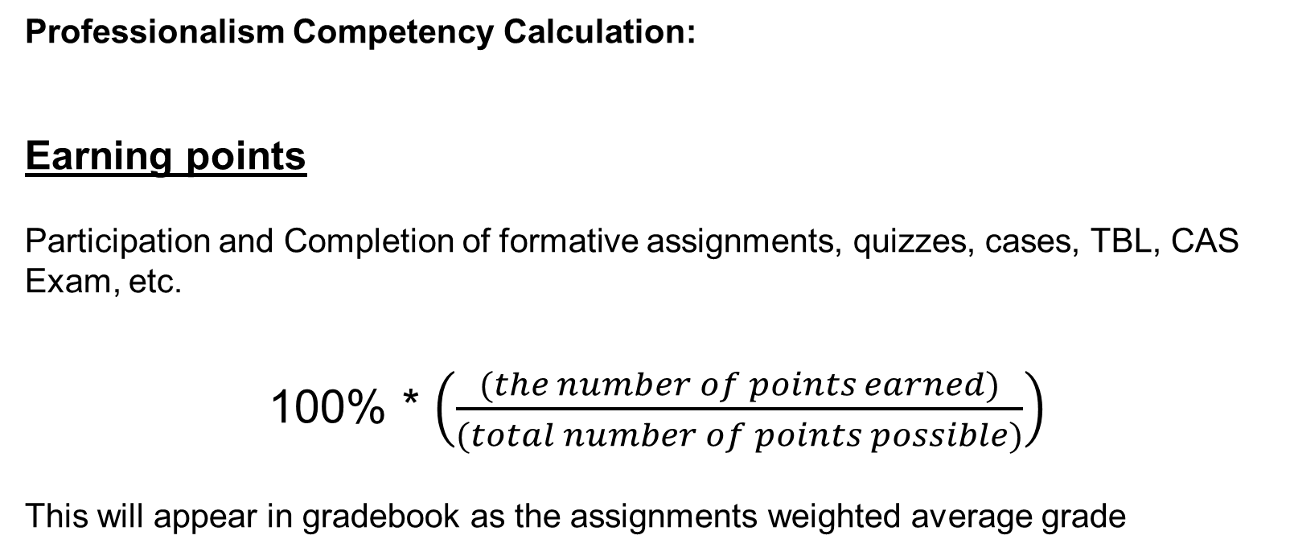
Professionalism Competency Calculation:
Earning points
Participation and Completion of formative assignments, quizzes, cases, TBL, CAS Exam, etc.
100% * $\left(\frac{(the number of points earned)}{(total number of points possible)}\right)$
This will appear in gradebook as the assignments weighted average grade

Slide 7
Professionalism Competency Calculation:
Losing Points
From your earned points, you can have points deducted
Losing points
You will lose Professionalism points based on:
Late arrival to or absence from exams, or failure to follow directions,
Late submission of assignments or failure to complete them as directed,
Late arrival to, or failure to participate in group activities, and other specified activities (denoted by asterisks on the schedule)

Slide 8
Professionalism: How to lose points
Exam professionalism | Unexcused late arrival to exam (per handbook tardy policy) (Late > 20 minutes = absence) | > 20 minutes | subtract 16% for each instance
 |  | < 20 minutes | subtract 5% for each instance
 | Failure to follow directions for exams (e.g. turning in scratch sheets, showing green screen, putting away notes/cell phones, etc.) |  | subtract 2% for each instance
Attention to detail | Failure to follow directions in activities or submission of an assignment that is not completed as directed |  | subtract 2% for each instance
Timeliness | Late assignment submission by < 1 hour |  | subtract 2% for each instance
 | Late assignment submission by 1-24 hours |  | subtract 3% for each instance
 | Late assignment submission by > 24 hours |  | subtract 5% for each instance
Participation | Failure to participate in, or late arrival > 15 minutes to asterisk-specified activities (loses points in addition to any assignment points subtracted for assignments associated with that activity). (Late arrival by >20 minutes is considered an absence) |  | subtract 5% for each instance
Policy: All absences for any reason count toward the 21% of permissible missed * events. ~ Use yours wisely! ~

Slide 9
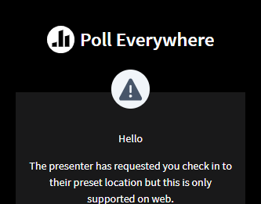
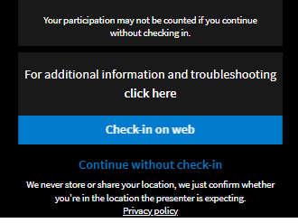
Participation
Poll Everywhere: NPMSD
Log in using TouroOne email
Check in on web to register your location
Geolocation settings are set for buildings on campus
Note: Claiming presence for an event you are not present at is a serious academic honesty violation

Slide 10
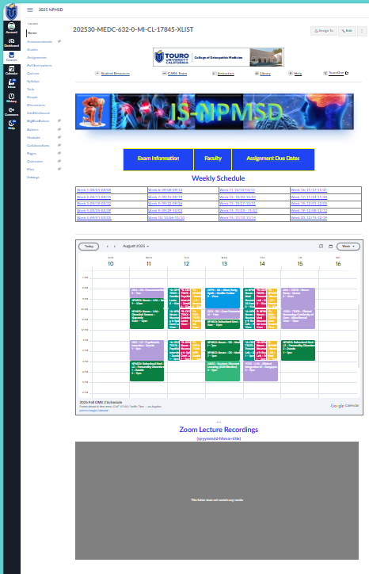
Canvas Home Page
Weekly Schedule Pages
Official Google calendar
Lecture recordings
Exam Information Page
Faculty pages
Assignment due dates and answer keys
Syllabus
Canvas Calendar
Notes:
The best way to access material is through the canvas course. On the homepage you will find ***the weekly schedule pages, ***the official Google Calendar, ***a link to the exam information page, ***a link to faculty pages, ***a link to an assignment information page and ***in the left sidebar you will see links to the syllabus ***and the canvas calendar.

Slide 11
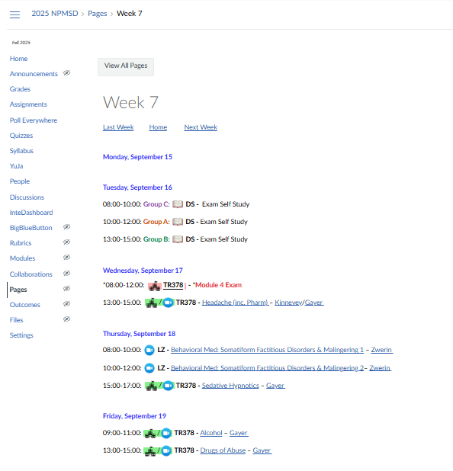

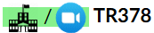


Weekly Schedule Pages
Hyperlinks to
Zoom session
Lecture page
Faculty Page
Groups are color coded
Icons:
Directed Study
Campus+Live Zoom
Zoom only
Campus only
Zoom Passcode
for all sessions:
npmsd
Notes:
The weekly schedule Pages contain hyperlinks to all of your curricular materials. Zoom links are live and will open up the scheduled zoom session. Clicking on the name of the lecture will open up the lecture page in canvas. and clicking on the professor's name will open up that professor’s faculty page.
When there are group activities, you will generally be using your TBL groups. Many of these events are split into triplicate for the A/B/C groups, and these group times are color coded on the weekly schedule pages. In addition, we have used icons for directed study, live zoom, and on campus activities to make it easy to see at a glance which events are live or self-study, and where you need to be for them. Depending on how you join zoom, you may be required to enter a passcode. The passcode for all IS-NPMSD zoom sessions is npmsd - all lowercase.
On a technical note, because all of the hyperlinks are embedded on this page, you may find it convenient to copy and paste the text from these pages into a document or an email to yourself. That way you can still access the zoom sessions and possibly even the lecture pages, even if the TouroOne server becomes non-functional and you cannot use that route to access Canvas.

Slide 12
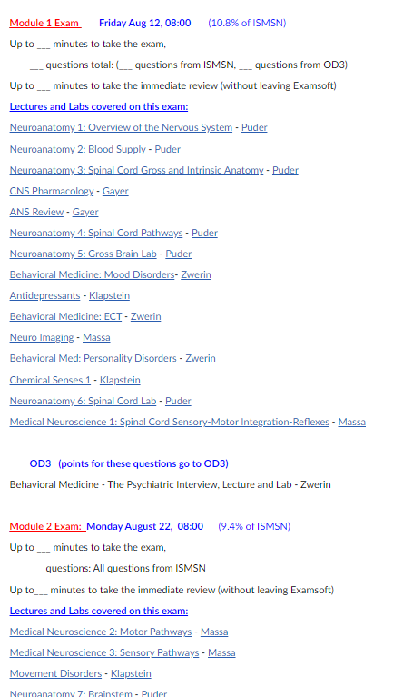
Exam Information Page
Date and weighting of exam
Actual start time may differ - Extra time reserved on official calendar
Some exams include OD3/OPP3 Qs
OD3 points go to OD3 gradebook
# of questions, length of exam, and threads will appear after the exam is made and edited.
Examsoft exams are in-person, on-campus
Excused absences need to be cleared by Academic Affairs before a make-up exam can be offered
Notes:
The exam information page is the place to find important information relevant to each of the Module exams. All of the lectures or labs covered on an exam are listed, with hyperlinks back to the lecture pages in Canvas. Lectures that occurs right before exams may be covered on the following exam, so you will have enough time to study the material. Please note that some of the exams include material from your other fall courses, such as Osteopathic Doctoring. Because OD3 and NPMSD have been closely integrated, there may be significant overlap in the testable material.
However, after each exam, questions from the OD3 course will be separated out and points for those questions will contribute to your OD3 grade, and questions from NPMSD will contribute to your NPMSD grade. Some information will not be available until the exam is created and proofed. Once the exam is ready for download, information about the number of questions, the duration of the exam, the duration of the immediate review, and the thread breakdown of the exam questions will be posted. When writing exams, we try to make the number of questions for each lecture representative of the amount of material covered. You can expect that a long lecture covering a lot of material will have more questions than shorter lectures.
On the course schedule, you may notice that a 4 hour block has been reserved for each of the Module exams. This was done to reserve the lecture hall, and to make sure that our accommodated students have sufficient time to take the exam. The actual starting time for most exams will likely be closer to 9am than 8 am, but this will be determined separately for each exam after the duration is calculated.
If you need to miss an exam, you will need to request an excused absence from the Academic Affairs department. Once they notify me that an excused absence has been granted, I will work with you to schedule a make-up exam.

Slide 13
Exams
Each Module Exam is followed by an immediate review
Scratch paper provided
Includes a section for noting technical issues, etc.
Contact professors after exam to challenge question content
Knowledge challenges submitted on scratch paper are not reviewed!
Exam metrics are reviewed carefully to correct key errors or bonus prior to releasing results
Score report will be generated by Examsoft
Notes:
Most of the exams will be about 90 to 150 minutes long, followed by 20-30 minutes for the immediate review. The immediate review function in Examsoft allows you to review the questions on the exam and shows you what the correct answer is and which answer you chose. We request that our professors also provide a rationale for each question, that explains why the answer choice is correct or gives hints on how to approach the clinical scenario. My experience is that students who make use of this exam review time wisely tend to do better in the course, and students who require remediation are more likely to report that they did not spend as much time reviewing their exams.
Scratch paper will be provided for you during the exam. There will be a section reserved on the scratch paper for you to note any technical issues that you find while taking the exam, such as images that don’t display, or duplicate answers, and so on. This space should not be used to submit challenges on the material covered, as these will not be reviewed by the faculty. If you do have questions or concerns about the medical knowledge or topics covered on the exam, you should contact the appropriate professor directly, after the exam.
Please be assured that the faculty do review the exam performance very carefully. Examsoft provides extensive statistical analyses that are very sensitive in identifying problems with questions. The vast majority of key changes or extra points that we have awarded in the past were based on these metrics rather than on submitted challenges.
Once we have analyzed the exam performance and made any necessary key changes, a score report will be generated and sent to you.

Slide 14
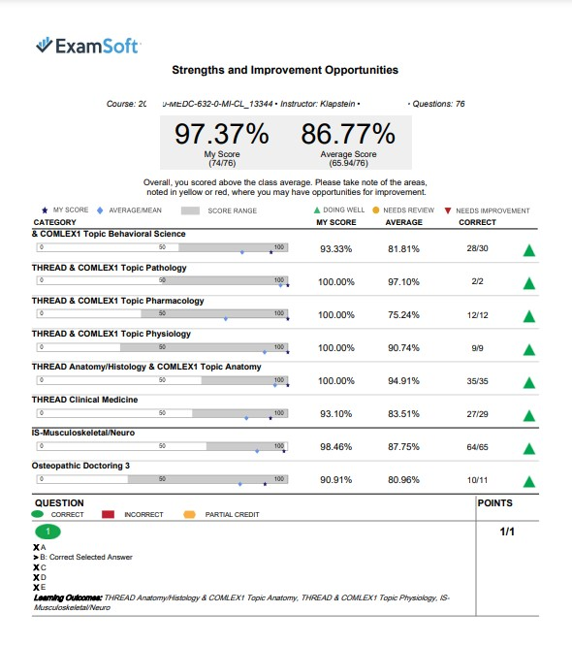
Score Report
Your score
Thread performance
Some exams include OD3 questions
Only NPMSD questions go to NPMSD gradebook!
Ignore score at top if there are OD3 questions on the exam
Your actual score will be displayed as a category
Questions order is scrambled on exams
Order on score report may be different from your exam
Notes:
The score report contains information you may find useful. your grade and the class average grade for the exam appear at the top. Under that is an analysis of your performance in the different threads.
If there are any questions from the doctoring course on the exam, then an analysis of questions from the different courses will appear under the thread analysis. Here you can see how you performed on the NPMSD part of the exam, and on the Doctoring part of the exam.
*** Please be aware that it is this grade from the NPMSD questions only that contributes to your grade book in NPMSD. In this situation, the large numerical percentages at the top of the score report will be irrelevant and will not match what you see reported in Canvas.
You should also be aware that the question order in examsoft will be scrambled, so the numbering of questions on the score report will probably not reflect the order you took them on the exam.

Slide 15
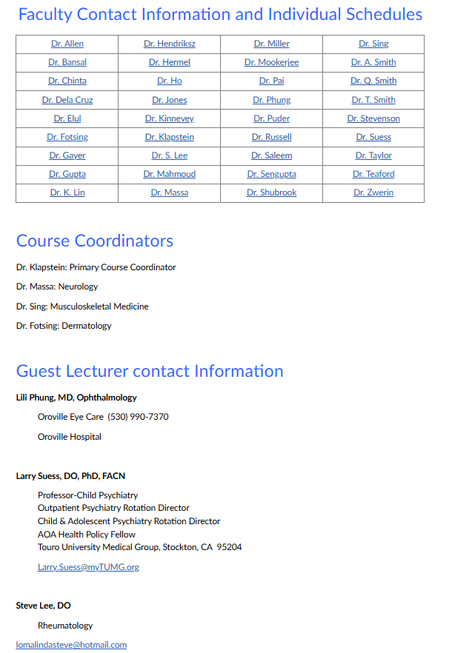
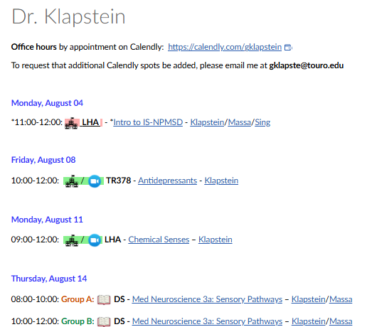
Faculty Pages
Contact information/email
Office hours, appointment links
Links to special content
Info from weekly schedule
Guest lecturer contact information
Notes:
The Faculty Pages contain contact information and office hours or appointment links that are supplied by the faculty. In some cases faculty may also choose to post links to special content such as this link to a study strategies lecture that I posted on my own faculty page. There is also a list of the curricular events delivered by the faculty member throughout the course, which was copied over from the weekly schedule, including hyperlinks to zoom and lecture pages.
There will be several guest speakers in the ISMSN course. Contact information for these speakers will be posted here when it is available.

Slide 16
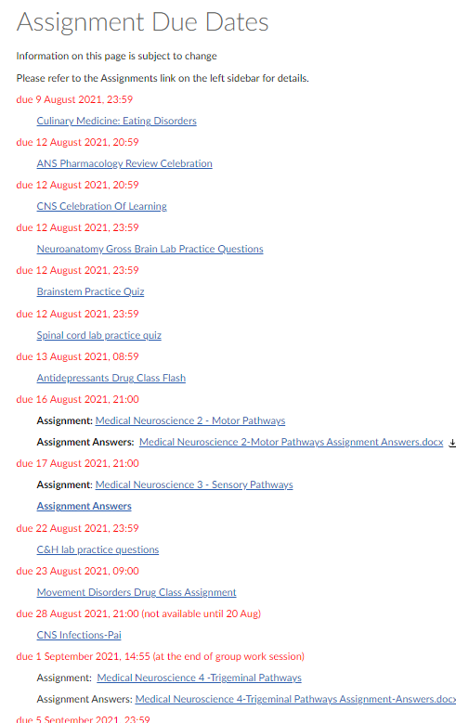
Assignment Due Dates
Large Blue button on home page
Different from link in left sidebar
Students should also check the left sidebar Assignments page directly
Due dates
Link to Assignments
Answer files (as applicable)
Will get populated as term goes on
Some Assignments with due dates also appear on Canvas NPMSD Calendar
Notes:
The assignment due dates page can be accessed by clicking on the large blue button on the homepage this is different from the assignment link on the left sidebar. Information posted on this page will include due dates for upcoming assignments, links to the assignments, and answer files, if applicable. There isn’t much there yet, but the list will grow as the term goes on.

Slide 17
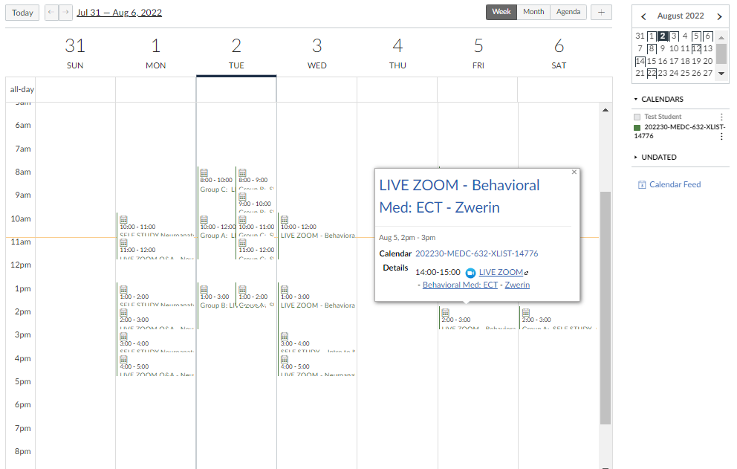
Canvas Calendar
Access from left sidebar
All events from weekly schedule and all assignment due dates appear here
Entries for lectures include hyperlinks to lecture pages and zoom sessions.
Bonus: if you access Canvas through a mobile device, note that the TU Banner on the home page is also hyperlinked to the calendar, so you can access zoom quickly!
Notes:
All of your lectures, exams, and assignments can also be found on the canvas calendar. Exams and assignments populate this calendar automatically when due dates are set, and lectures are copied here from the official course schedule. These calendar entries also have hyperlinks to the zoom sessions and lecture pages on Canvas. If changes are made to the official course they will appear before we get a chance to update this canvas calendar. In the event that discrepancies occur, then the Google Calendar should be considered correct.
If you ever need to access canvas on a mobile device, you might notice that the link to the canvas calendar is not readily available. For your convenience I have embedded a hyperlink on the TU Banner on the ISMSN home page that will take you to the canvas calendar, so you can access the zoom sessions and lecture pages with fewer clicks.

Slide 18
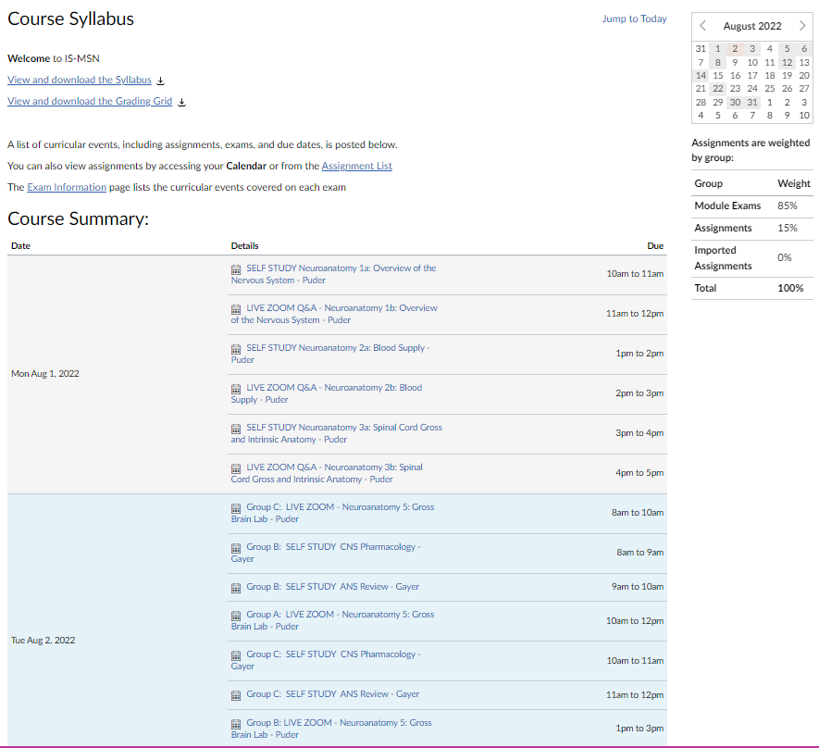
Syllabus
Access syllabus from link in left sidebar
Contains important information, policies
Includes all events appearing on the Canvas calendar, including assignment due dates, lectures, hyperlinks to calendar entries, etc.
Notes:
On the left sidebar you will see a link to the syllabus page. I hope you will take a few moments to read through the syllabus since it contains important information and outlines the policies that guide the course.
Also on this page you will see a course summary which is a list of everything that is on the canvas calendar. Clicking on any of these entries will open the canvas calendar.

Slide 19
The End!
Thanks so much for your attention.
I’m really excited to teach you this year!

